Slide 1
FIGMA PROJECT
TEAM MEMBERS:
ROHINI M
Ram Mithun s r
MUGUNTHAN M
RAGAVEENA A S
MONIKA SRI B
RAGAVI S
RAGUL D

Slide 2


Slide 3

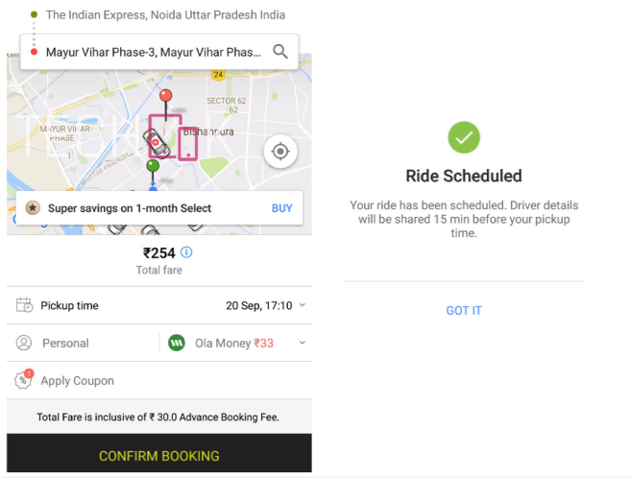

Slide 4
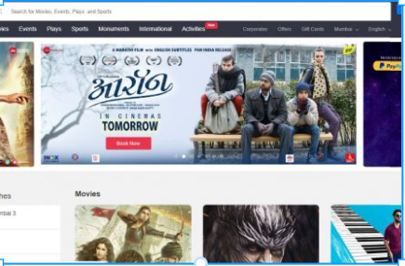
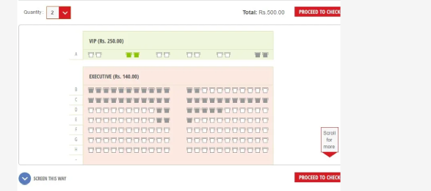

Slide 5



Slide 6
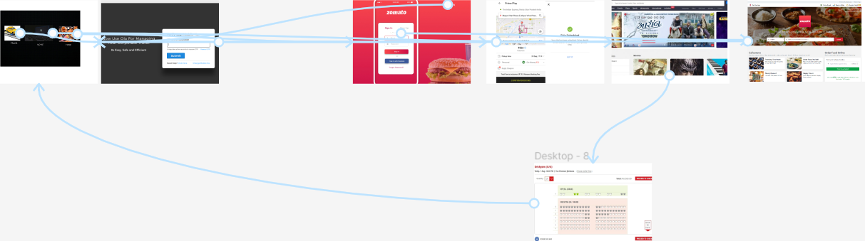

Slide 7
PROJECT URL
https://www.figma.com/file/GEvzNRJkqu6RbSq2n6bveX/Untitled?node-id=0%3A1
Git hub link
https://github.com/Rammithun/Rohini/upload/main

